Slide 1
Matlab程式設計_5_25
助教:金郁善

Slide 2
Simple image classification network
Load image data
Define the network architecture
Specify training options
Train the network
Predict the labels of new data and calculate the classification accuracy.
Download deep learning tool

Slide 3
Load data
digitDatasetPath = fullfile(matlabroot,'toolbox','nnet','nndemos', ... 'nndatasets','DigitDataset’);
% fullfile function : Builds a full file specification from the specified folder and file names.
imds = imageDatastore(digitDatasetPath, ...
'IncludeSubfolders',true, ...
'LabelSource','foldernames’);
% imageDatastore : to manage a collection of image files

Slide 4
numTrainFiles = 750;
% separate the images to 750images in one set to categorize the images
[imdsTrain,imdsValidation] = splitEachLabel(imds,numTrainFiles,'randomized’);
%splits the image datastore into two new datasotres for training and validation.

Slide 5
Define network architecture (deep learning layers)
inputSize = [28 28 1]; %28by28by1 pixels
numClasses = 10;
layers = [ imageInputLayer(inputSize)
convolution2dLayer(5,20)
batchNormalizationLayer
reluLayer
fullyConnectedLayer(numClasses)
softmaxLayer
classificationLayer];

Slide 6
Train the network
options = trainingOptions('sgdm', ...
'MaxEpochs',4, ...
'ValidationData',imdsValidation, ...
'ValidationFrequency',30, ...
'Verbose',false, ...
'Plots','training-progress’);
net = trainNetwork(imdsTrain,layers,options);

Slide 7
Test Network
YPred = classify(net,imdsValidation);
YValidation = imdsValidation.Labels;
accuracy = mean(YPred == YValidation)
accuracy ➔ 0.9888

Slide 8
HOMEWORK

Slide 9
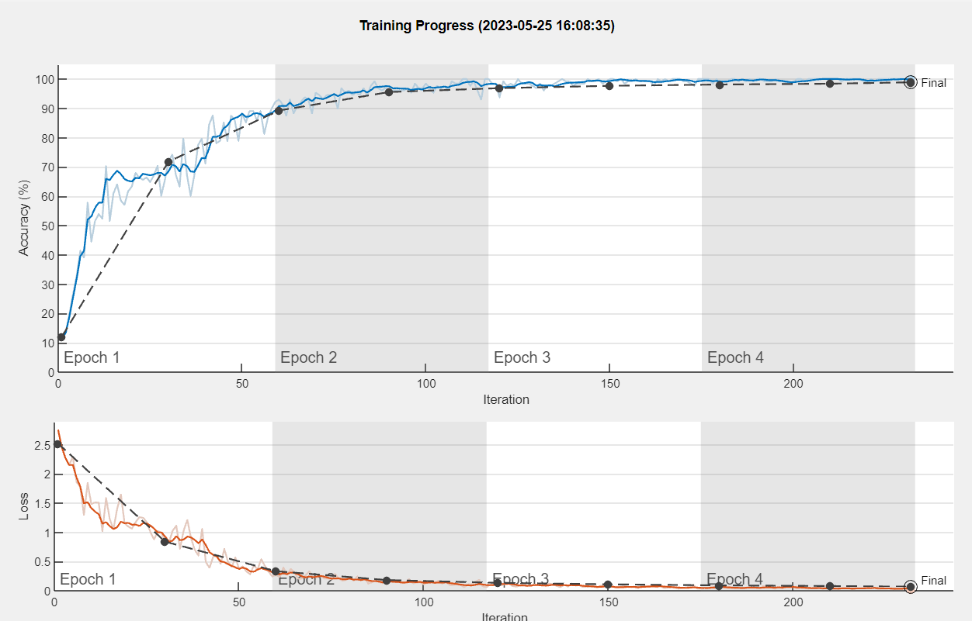
Upload the graphs and explain the process of deep learning

